Slide 1
Lab 1
Decision trees

Slide 2
ASSIGNMENT 1
DATASET | ENTROPY
MONK-1 | 1.0
MONK-2 | 0.95711
MONK-3 | 0.9998

Slide 3
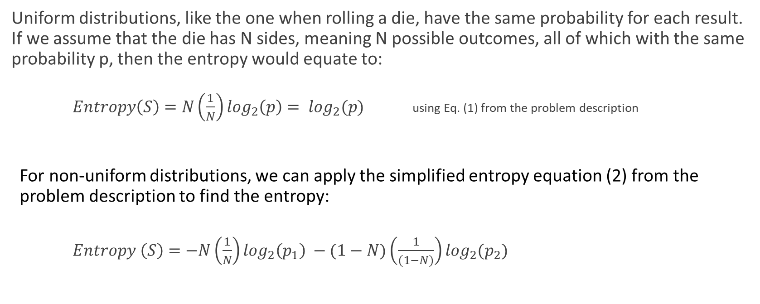
ASSIGNMENT 2
Uniform distributions, like the one when rolling a die, have the same probability for each result. If we assume that the die has N sides, meaning N possible outcomes, all of which with the same probability p, then the entropy would equate to:
$Entropy\left(S\right)=N\left(\frac{1}{N}\right)\log_{2}\left(p\right)= \log_{2}(p)$ using Eq. (1) from the problem description
For non-uniform distributions, we can apply the simplified entropy equation (2) from the problem description to find the entropy:
$Entropy \left(S\right)=−N\left(\frac{1}{N}\right)\log_{2}\left(p_{1}\right) −(1−N)\left(\frac{1}{(1−N)}\right)\log_{2}(p_{2})$

Slide 4
ASSIGNMENT 3
DATASET | A1 – Avg Gain | A2 – AVG Gain | A3 – Avg Gain | A4 – AVG gain | A5 – avg gain | A6 – avg gain
MONK-1 | 0.07527 | 0.005838 | 0.004707 | 0.026311 | 0.28703 | 0.0007578
MONK-2 | 0.003756 | 0.002458 | 0.001056 | 0.01566 | 0.017277 | 0.0062476
MONK-3 | 0.007120 | 0.29373 | 0.0008311 | 0.002891 | 0.25591 | 0.007077

Slide 5
ASSIGNMENT 4
We seek to find the subsets for which the information gain is maximized.
This can be seen as choosing the attribute for which the entropy is closest to 0.
By choosing the attribute with the lowest entropy, a subset Sk can be made which has the highest information gain.
The entropy of the attribute is compared in this case to the root node, and the attribute for which Ent(S) – Weighted Ent(Sk) is maximized, is chosen.
This process occurs recursively, which the new subset is further divided until no further statistically significant improvement in information gain is observed.

Slide 6
ASSIGNMENT 5
DATASET | E-train | E-test
MONK-1 | 1 | 0.82870
MONK-2 | 1 | 0.69212
MONK-3 | 1 | 0.94444

Slide 7
ASSIGNMENT 6
An increasingly complex tree will reduce the amount of bias of the model, as the biased parameter would affect the overall performance less.
However, a more complex tree may result in overfitting which can be shown as the amount of variance. Therefore, we have a trade-off between reducing bias or reducing variance.
By pruning, the complexity and dimensionality of the tree can be reduced by removing redundant tree nodes that do not affect performance. Meaning, that we can reduce variance by reducing complexity, while retaining low bias as the removed nodes are redundant.

Slide 8
ASSIGNMENT 7 MONK-1
PRUNED
FRACTION | MEAN ERROR | STDEV
0.3 | 0.228 | 0.041
0.4 | 0.203 | 0.0415
0.5 | 0.18 | 0.04266
0.6 | 0.162 | 0.04375
0.7 | 0.148 | 0.0446
0.8 | 0.141 | 0.045166
NON-PRUNED
FRACTION | MEAN ERROR | STDEV
0.3 | 0.265 | 0.067
0.4 | 0.234 | 0.0705
0.5 | 0.206 | 0.073
0.6 | 0.187 | 0.075
0.7 | 0.173 | 0.0772
0.8 | 0.169 | 0.0796667

Slide 9
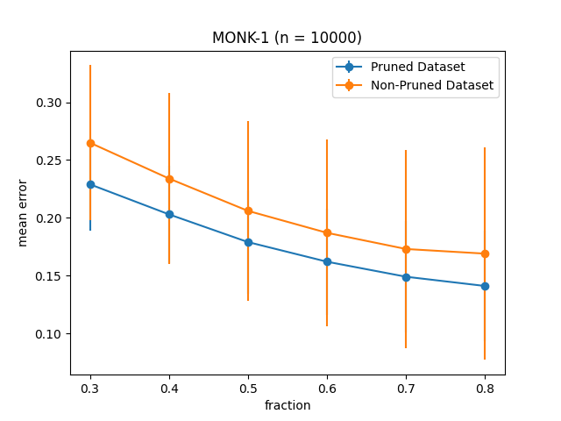
ASSIGNMENT 7 MONK-1

Slide 10
ASSIGNMENT 7 MONK-3
PRUNED
FRACTION | MEAN ERROR | STDEV
0.3 | 0.085 | 0.055
0.4 | 0.061 | 0.049
0.5 | 0.048 | 0.04433
0.6 | 0.042 | 0.04125
0.7 | 0.042 | 0.039
0.8 | 0.048 | 0.03766
NON-PRUNED
FRACTION | MEAN ERROR | STDEV
0.3 | 0.152 | 0.062
0.4 | 0.133 | 0.0545
0.5 | 0.125 | 0.05
0.6 | 0.121 | 0.04825
0.7 | 0.116 | 0.048
0.8 | 0.114 | 0.0495

Slide 11
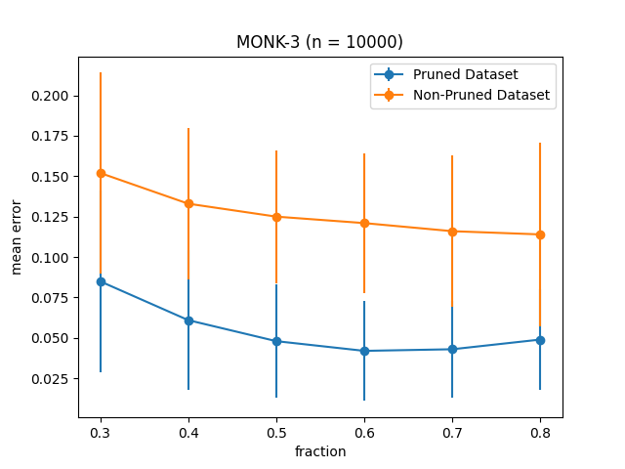
ASSIGNMENT 7 MONK-3

